Slide 1
Labana world travel
Rajasthan Tour Packages

Slide 2
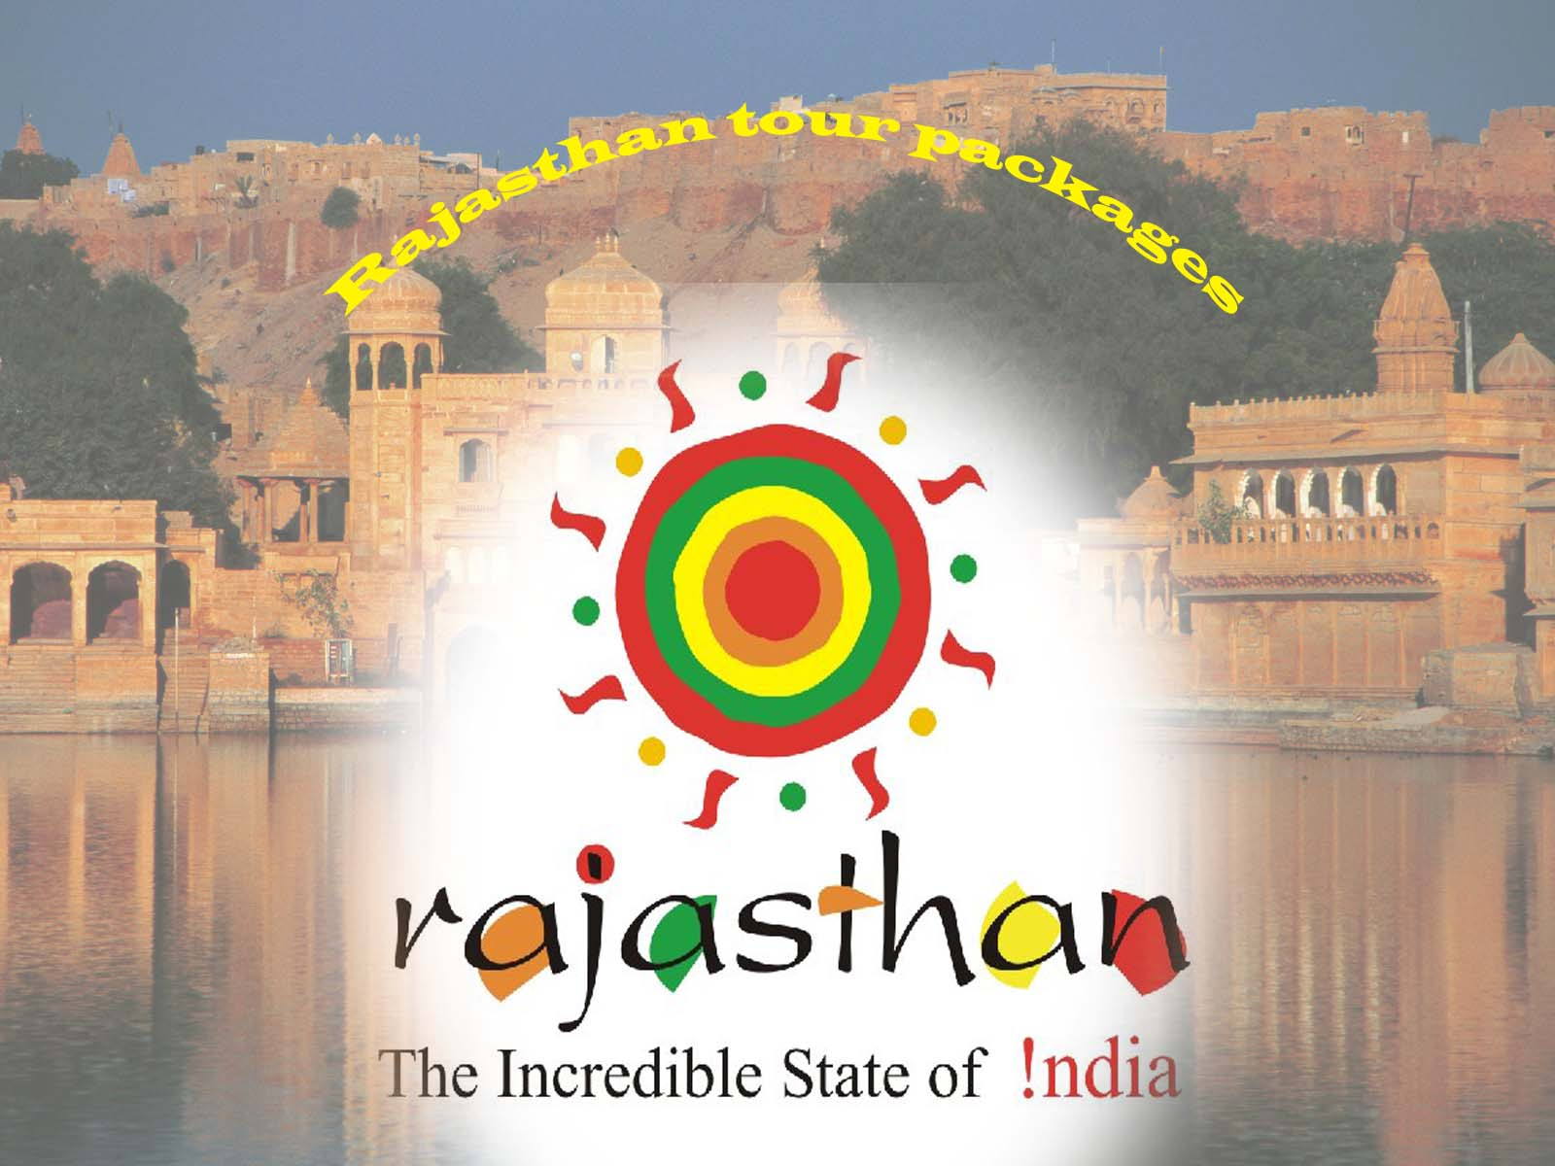
The royal trail of Rajasthan

Slide 3
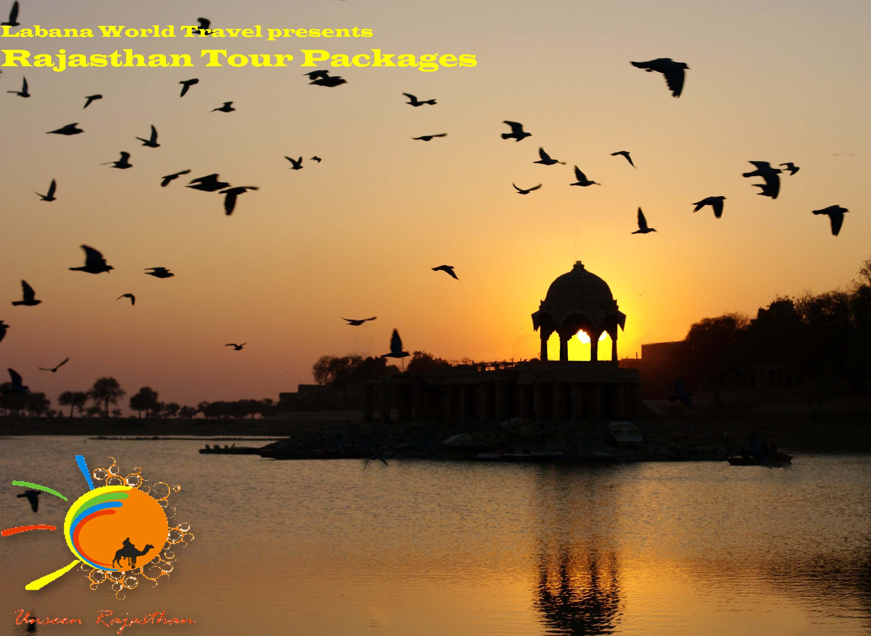
Take a royal entourage to Rajasthan

Slide 4
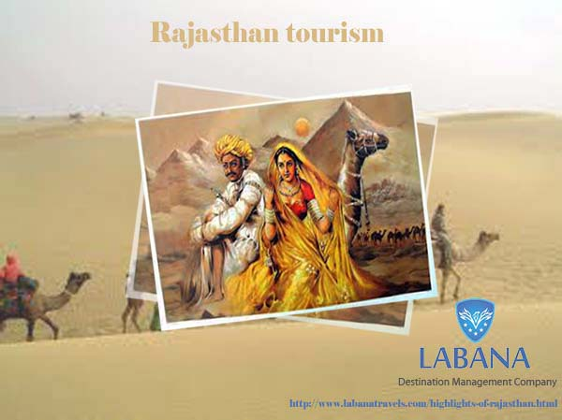
Rajasthan Tourism, the most admired entourage in India

Slide 5
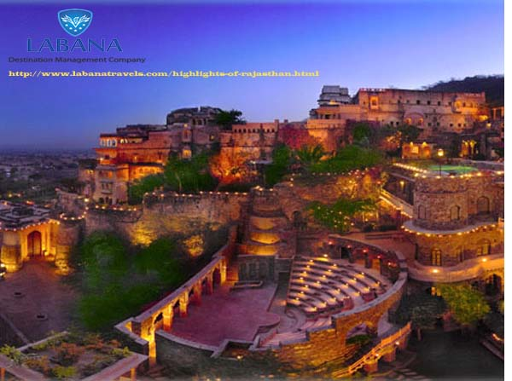
The royal Heritage of India in Rajasthan

Slide 6
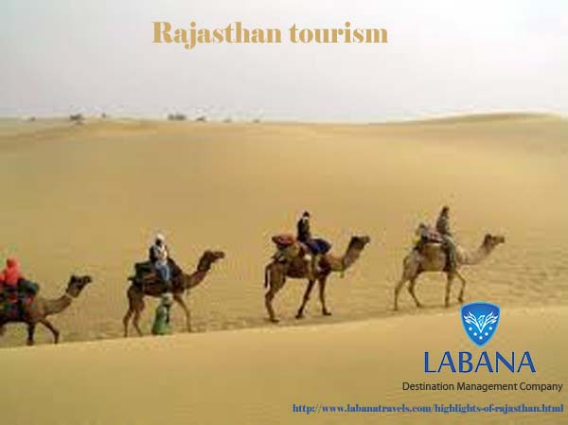
Explore the haven of Thar Desert

Slide 7
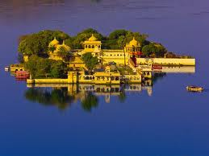
Experience the charisma of India with charismatic Rajasthan

Slide 8
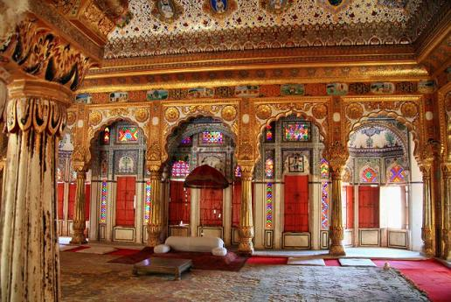
Embark on for the luxurious royal circuit in India

Slide 9
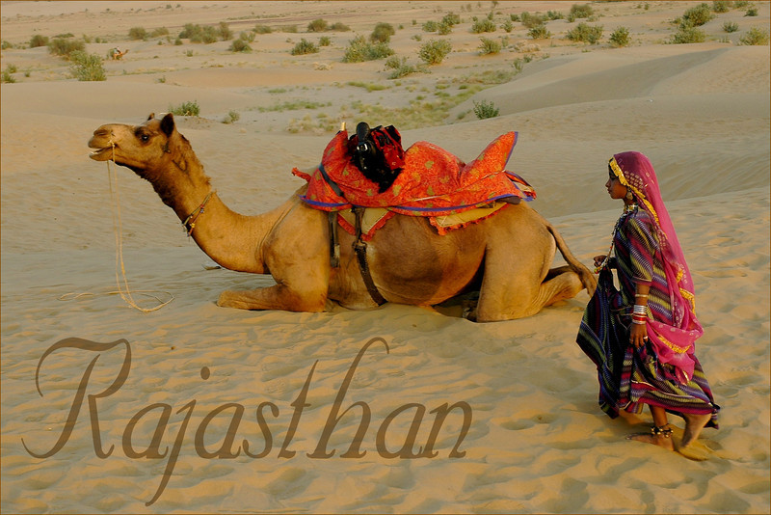
Roll down in the golden sands of the vast dessert of Thar in Rajasthan

Slide 10
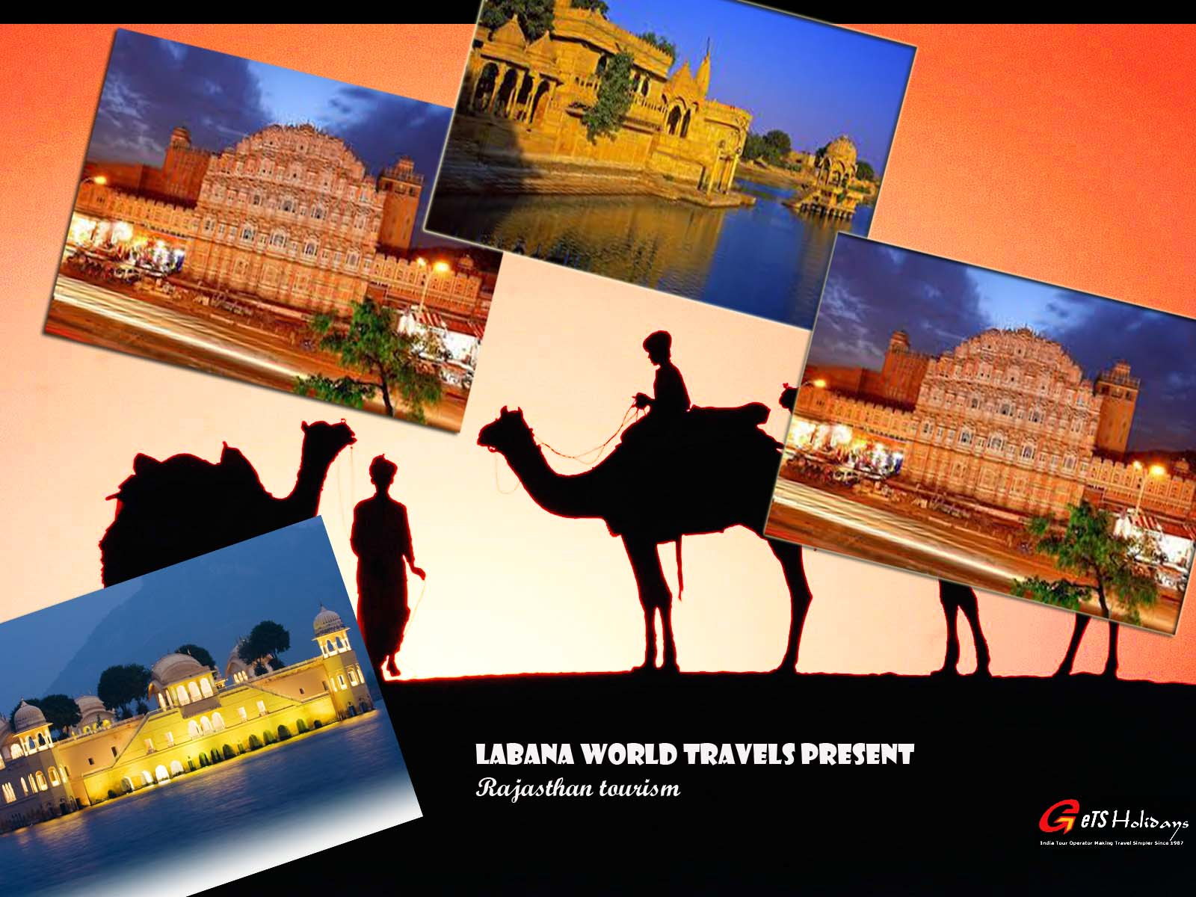
Take a royal tour to the royal Rajasthan

